Slide 1


Kickstarter Technical Presentation
Presenter: Jake Ehlers
Date: 7/20/20

Slide 2
Using Kickstarter project data from 2009 to 2017, determining characteristics that lead to successful projects is key to give insight on what to focus into new projects in the coming year.
Using descriptive and inferential methods, found success percentage as well as correlation to success with main categories and other variables
Dance, Theater, Comics and Music are among the most successful main categories; Technology, Journalism, Crafts and Food are among the least successful
Backers and pledge amount positively correlated with success, project duration and launch year negatively correlated with success

Slide 3
In analyzing Kickstarter project data:
Which categories/main categories are more successful?
How does project success change over the 2009-2017 timeframe?
Do successful projects overshoot their goal by a lot?
Do backers pledge large amounts to projects, or is most of the funding made by a large number of backers?
How can future projects make themselves more likely to succeed?

Slide 4
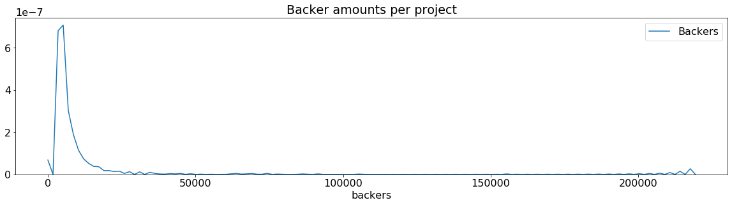
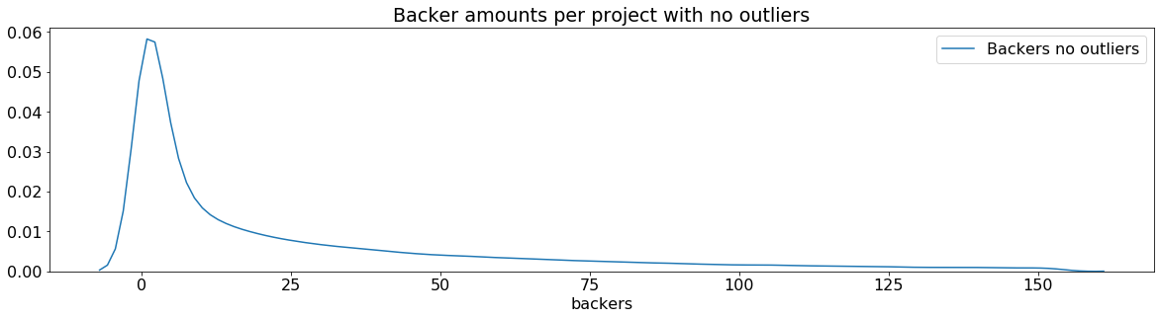
In observing measure of central tendency for number of backers, amount pledged, and goal amounts, the distribution is skewed to the right, so using median over average to describe central tendency is better.

Slide 5
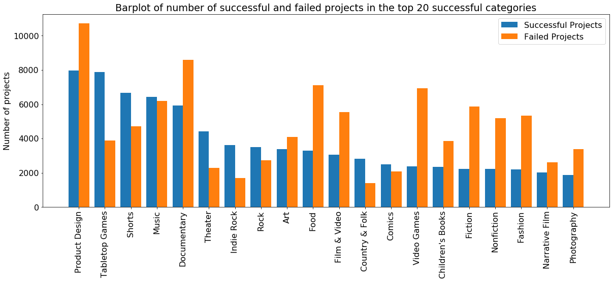
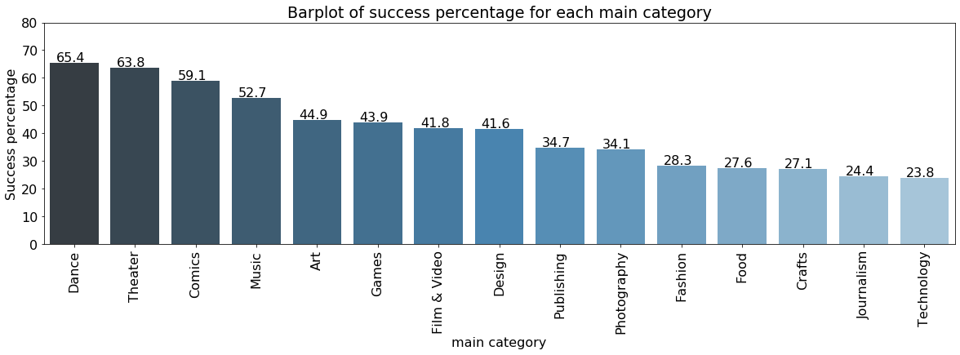
Looking at the main categories to see which are the most successful, we see some that do have many successful projects, but also many failed. Using success percentage to rank categories is better than the number of successful projects.

Slide 6
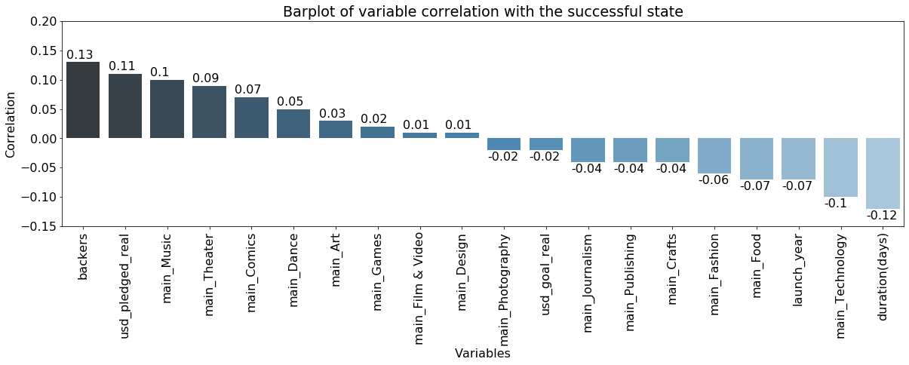
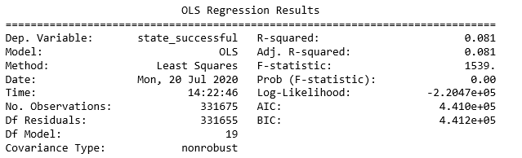
Correlated columns with the successful state to see if any strong relationship exists, and while the correlations are weak, they still show which categories have a positive and a negative relationship with success.
Backers and pledged amounts are positively correlated unsurprisingly
Project duration has a negative correlation
When building a least squares model for success using these variables, we observe a low r-squared value of 0.081, so our model doesn’t explain the variation well.

Slide 7
Using descriptive and inferential statistical methods, determined some successful and not-as-successful main categories and other indicators to success.
Longer project duration had a negative correlation with success, so projects should look at keeping a shorter funding time/not extend their deadline if the goal isn’t reached yet, as well as concentration advertising during the shorter timeframe.
While the model isn’t a good predictor of success, we can still observe categories of Dance, Theater, Comics and Music to be more likely to be successful in completing their funding.
Having more data on each project including pledges over the funding timeframe, descriptions of the project, and pledge rewards can potentially be used to give more insight into successful projects.

